Slide 1
CAPSTONE PROJECT-1
EDA on Hotel Booking Analysis
BY
Jatin Kanyan

Slide 2
PROBLEM Statement:
In this particular Project we are going to analyze Hotel Booking dataset . This dataset contains
information of city hotel and resort hotel, and includes information of booking time, length of stay , number of adults, children and/or babies, also have information of available parking space, among other things.
The objective of this project is to explored and analyze the data to discover important determinant that affects the
booking.

Slide 3
DIVISION OF WORKFLOW:
EDA IS FURTHER DIVIDED INTO THREE STEPS:
Univariate analysis
Bivariate analysis
Multivariate analysis
DATA COLLECTION AND UNDERSTANDING.
DATA CLEANING AND MANIPULATION
EXPLORATORY DATA ANALYSIS

Slide 4
DATA COLLECTION AND UNDERSTANDING:
Data collection and understanding is very crucial to have first hand insight from the dataset.so, this hotel booking dataset contains 119390 rows and 32 columns.
Let us now understand what these all columns or features depicts:
Hotel: type of hotel city or resort.
Is_cancelled: hotel once reserved was cancelled or not which is described in binary format.
Lead_time: it describes the time between booking date and arrival date of the customer.
Arrival_date_year: this describes the year of the arrival date.
Arrival_date_month: this describes the month of the arrival date.
Arrival_date_week_number: this describes the week number of the arrival date.
Arrival_date_day_of_the_month:it describes the day of the month of the arrival date.

Slide 5
8.) Stays_in_weekend_nights : it describes the number of the weekend nights the guest is planning to stay.
9.) stays_in_weekdays_nights: it describes the number of the weeksdays the guest is planning to stay.
10.)adults : the number of adults included in the reservation
11.)children: the number of children included in the reservation.
12.)babies: the number of babies included in the reservation.
13.)meal:the type of meal included in the reservation . which could be options like breakfast, half-board, full-board or unspecified.
14.) country: the county from where the guest belongs.
15.) market_segment: it designates the type of customer segment(e.g. online travel agents, direct,corporate)
16.) distribution channel: the distribution channel through which the reservation was made (e.g. online travel agents, offline travel agents, direct booking)
17.)Is_repeated_guest: binary flag (1 if guest had visited before and 0 if it’s the first visit)
18.)previous_cancellations:the number of previous cancellations by the guests.
19).previous_bookings _not_cancelled:the number of previous bookings made by the guests that were not cancelled.
20.)reserved_room_type : the room type reserved by the guest.
21.)assigned_room_type: the room type assigned to the guest upon arrival.
22.) booking_changes:the number of changes made to the booking.
23.) deposit_type: the type of deposit made for the reservation(e.g. no deposit,refundable,non-refundable).
24.)agent: the ID of the travel agency that made the booking.
25.)Company:the ID of the travel agency that made the booking.
26.)days_in_waiting_list:the number of days the booking was on the waiting list.
27.)customer_type: the type of customer making the reservation (e.g. transient, contract,group)
28.) adr: the average daily rate( the average revenue per available room) for the reservation.
29.)required_car_parking_spaces:the number of car parking spaces required by the guest.
30.)total_of_special_requests: the total number of special requests made by the guest.
31.)reservation _status:The reservation status at the time of data collection(e.g. Check-out,Cancelded,No-Show).
32.)reservation_status_date: the date on which the reservation status was recorded.

Slide 6
DATA CLEANING AND UNDERSTANDING
Given data has 31994 identical values which needs to be removed before proceeding further.
Dataset consists of four columns that have missing values which are as follows:
Company (94 % missing values)
Agent(14 % missing values)
Country (.5% missing values)
Children(0.0045% missing values)
so to overcome this problem we will remove the country column almost all the values are null.
In the country column we will replace the null values with “OTHERS”.
In the children column we will replace the null values with 0.
And in the agent column we will fill the null values with the median.
3. There are some rows in data that have total number of adults , children or babies equal to zero .this means there is no booking made. So I remove such rows.
4. then we formed another column named “total_people” by adding by adding three columns named “babies”,”adults” and “chlidren”.
5. We also formed a column named “total_stay” by adding “stays_in_weekend_nights” and “stays_in_week_nights”.

Slide 7
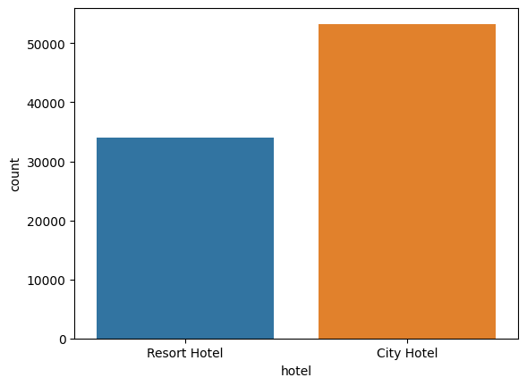
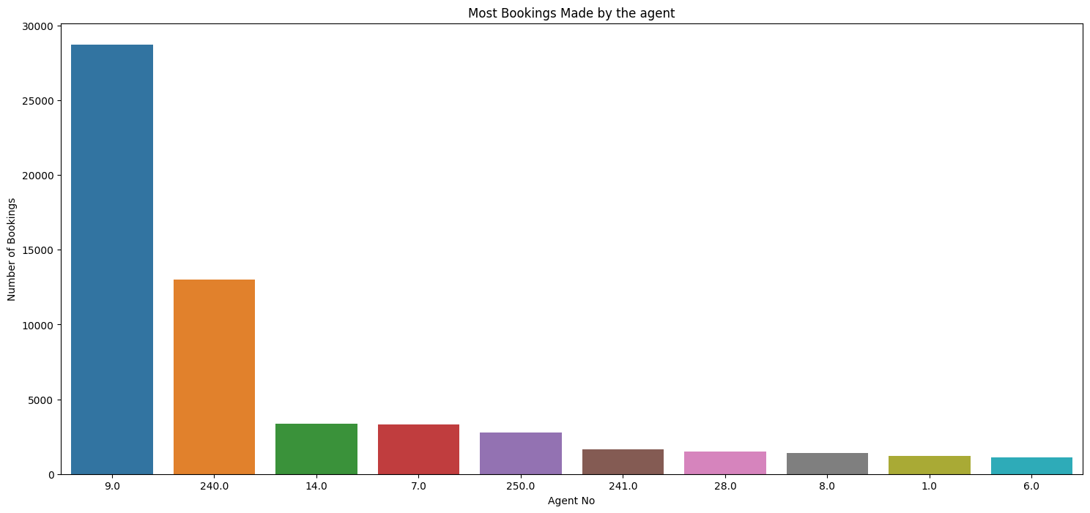
EDA : UNIVARIATE ANALYSIS
Conclusion:
1. As per insights by the column charts given above we can depict that city hotel is the preferred hotel type over resort hotel.
2. Agent no. 9 made most of the bookings which means he is the most preferred agent for booking followed by agent no. 240.

Slide 8
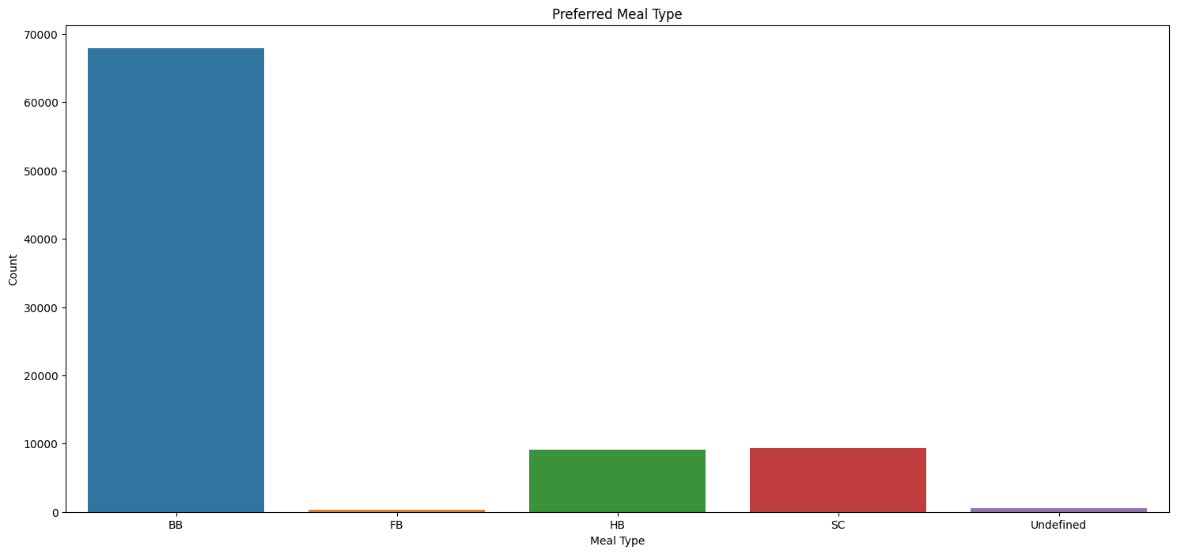
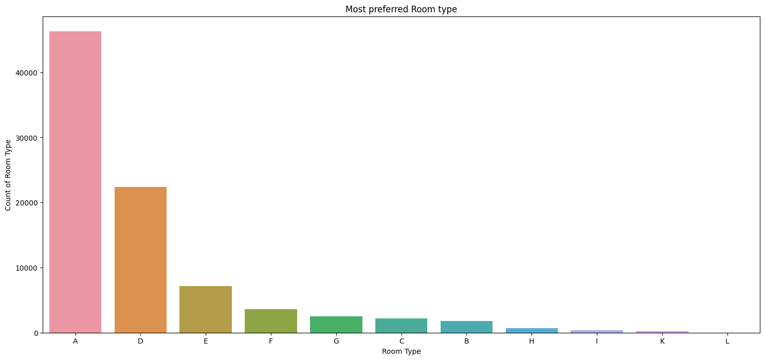
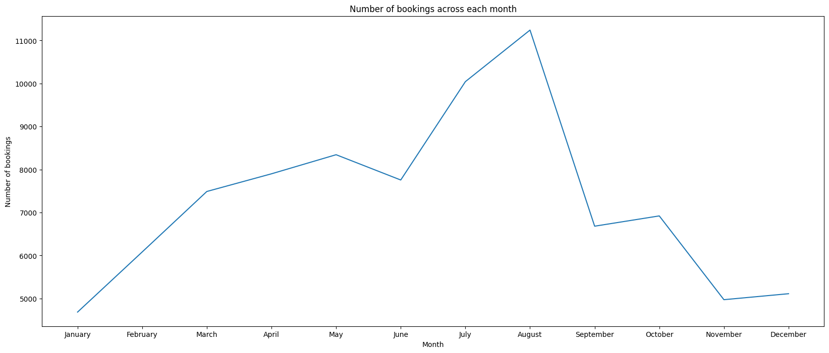
EDA: UNIVARIATE ANALYSIS
CONCLUSION:
BB meal type is the most preferred meal type and 67907 number of guests prefers this particular food type.
Room type “A” is the most preferred room type followed by room type “D”.
August month has the maximum number of bookings with count 11242 which means it is the most busiest month.

Slide 9
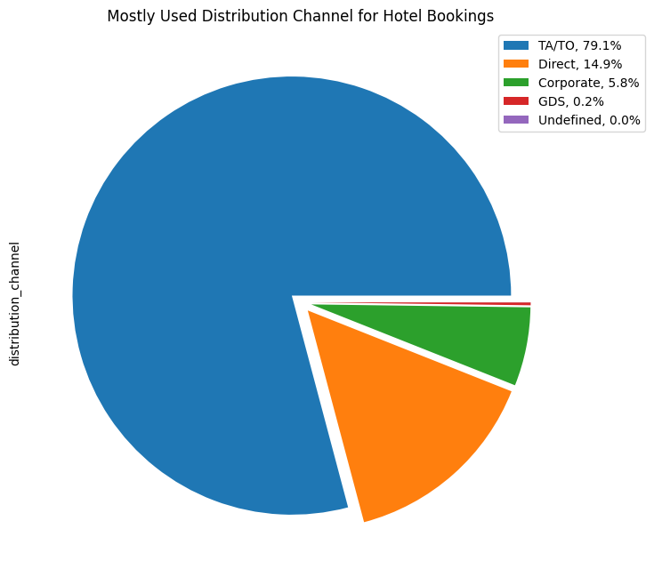
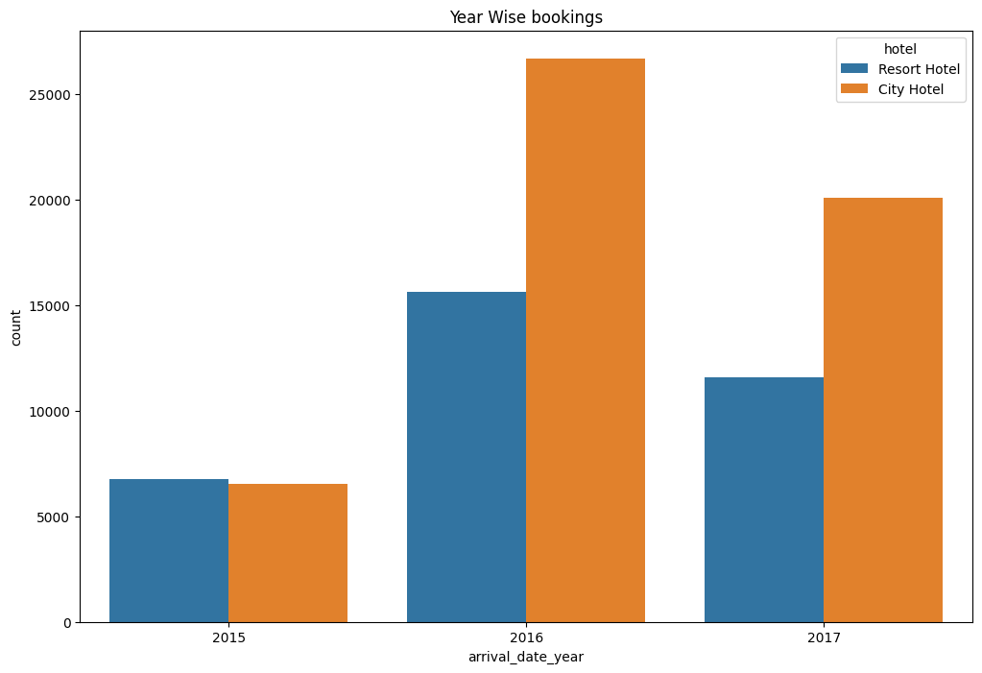
EDA: UNIVARIATE ANALYSIS
CONCLUSION:
Most popular booking channel is ‘TA/TO’ with total share of 79.1% in booking followed by ‘Direct’ which has a percentage share of 14.9%.
The year 2016 had the highest bookings in both the hotel types with count 42313 and the year 2015 had the lower number of bookings.

Slide 10
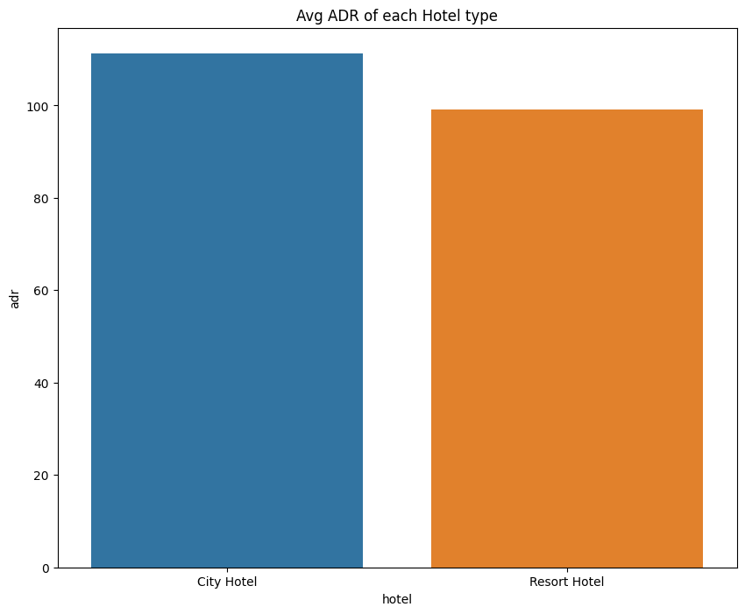
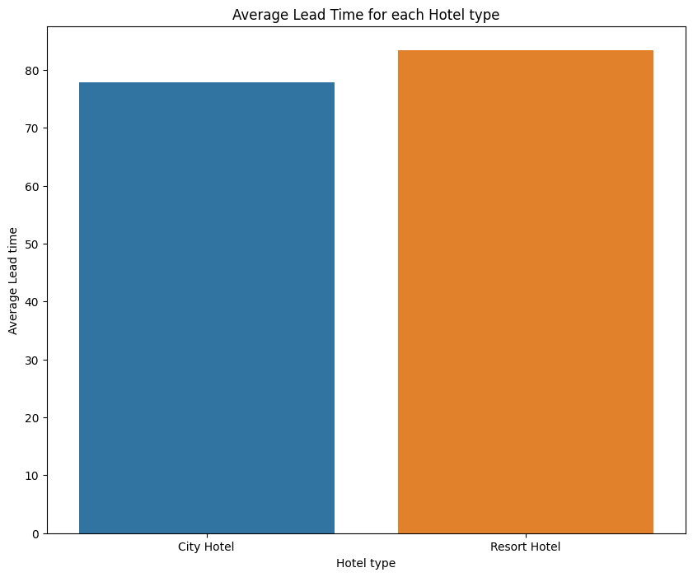
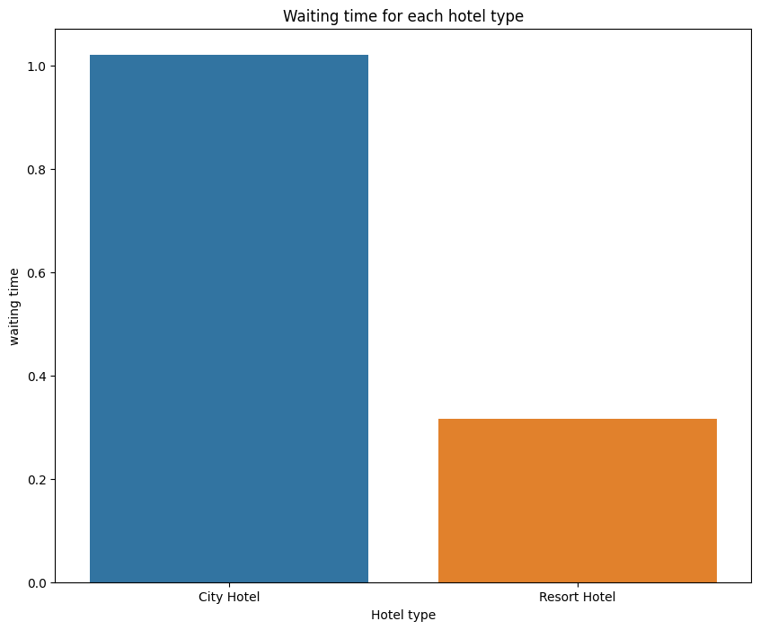
EDA: BIVARIATE AND MULTIVARIATE ANALYSIS
CONCLUSION:
City hotel has highest ADR which means city hotels are producing more revenues than the resort hotels and the average ADR for city hotel is 110.98 .
Average lead time for resort hotel is relatively high compared to city hotel.
City hotel has a significantly long waiting time so the city hotel is busier hotel.

Slide 11
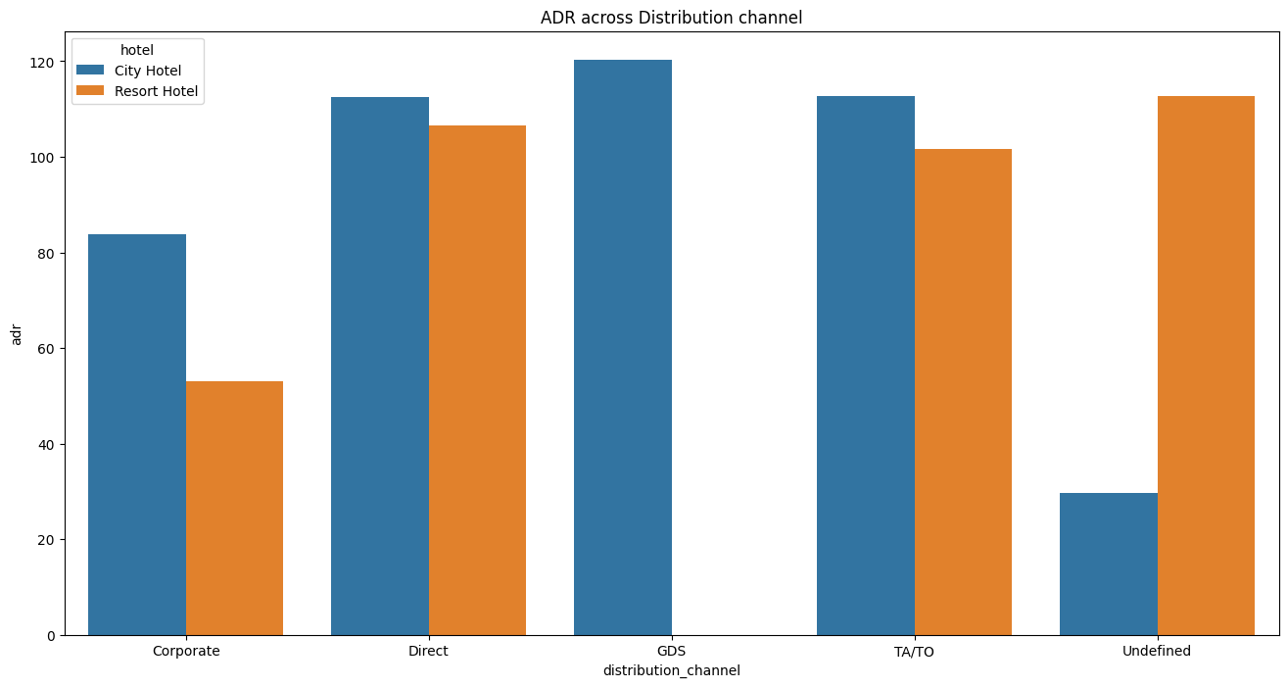
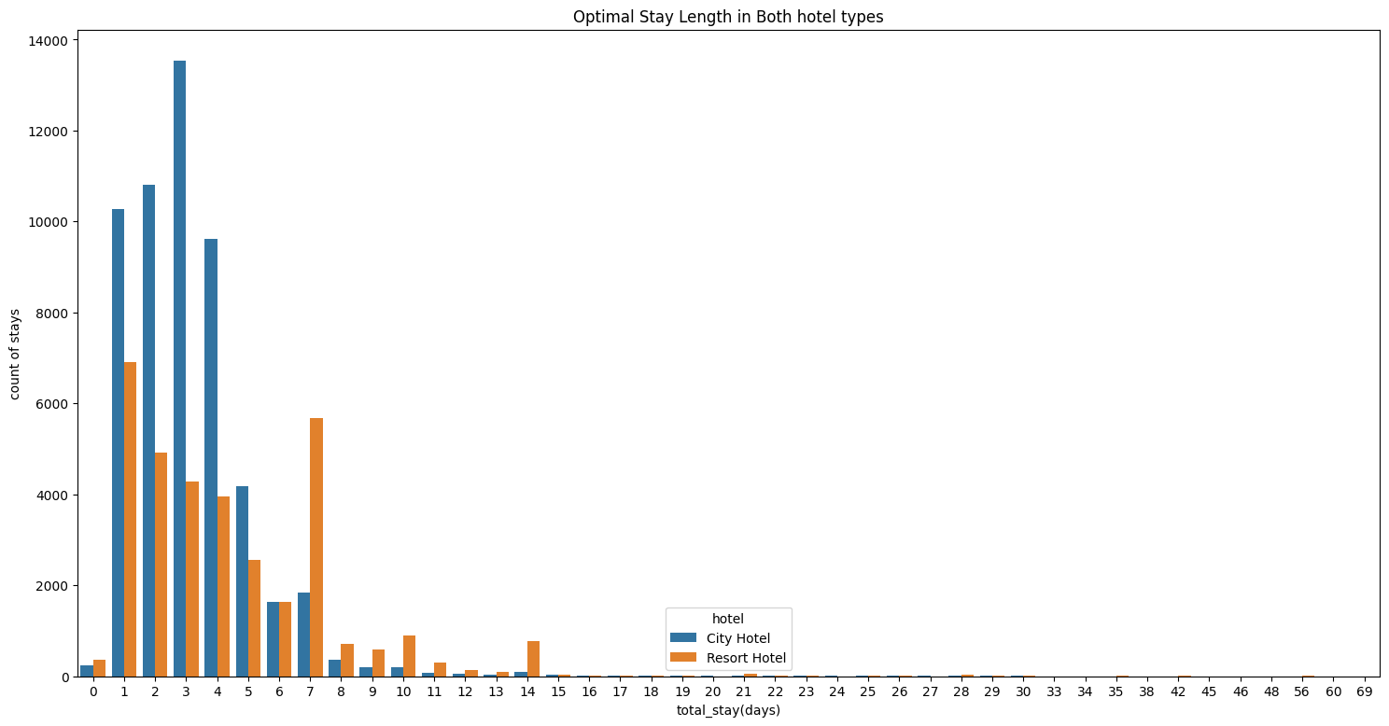
EDA: BIVARIATE AND MULTIVARIATE ANALYSIS
CONCLUSION:
1.GDS distribution channel contributed more to ADR in a city hotel and the Direct and TA/TO has nearly equal contribution to ADR in both types of hotel.
2. Optimal stay length in both hotel types is less than a week

Slide 12
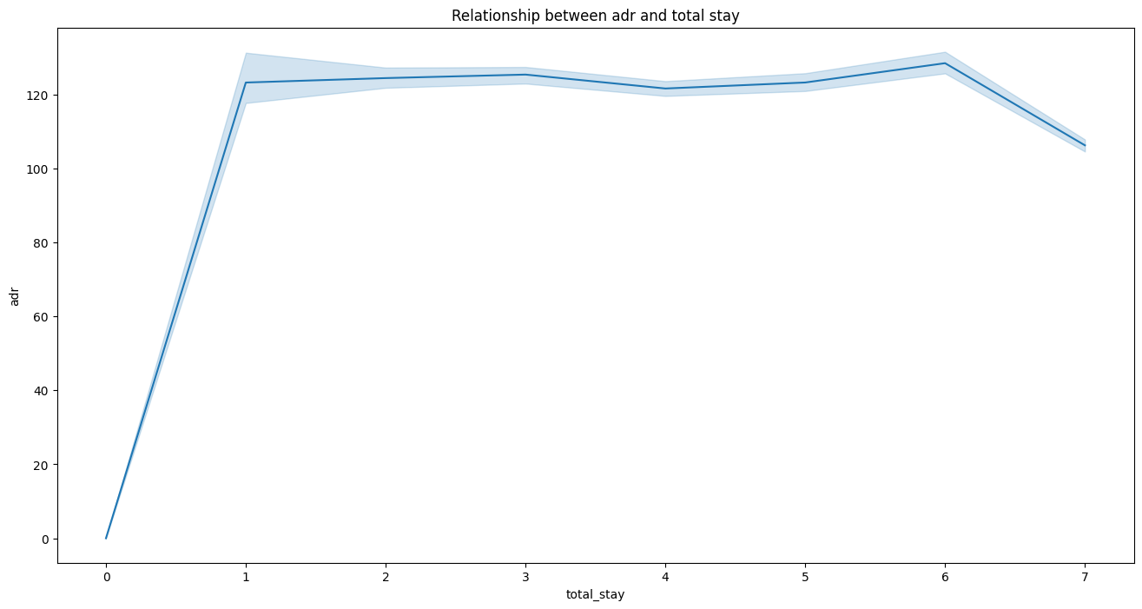
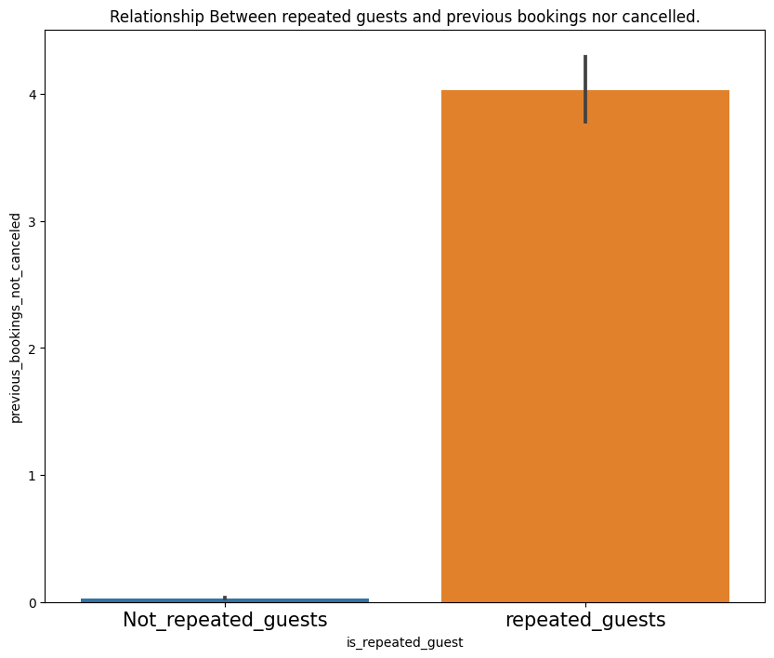
EDA: BIVARIATE AND MULTIVARIATE ANALYSIS
CONCLUSION:
If the number of total stay increases ADR also increases and revenue also increases
Repeated guests do not cancel their bookings but repeated guests cancel their bookings.

Slide 13
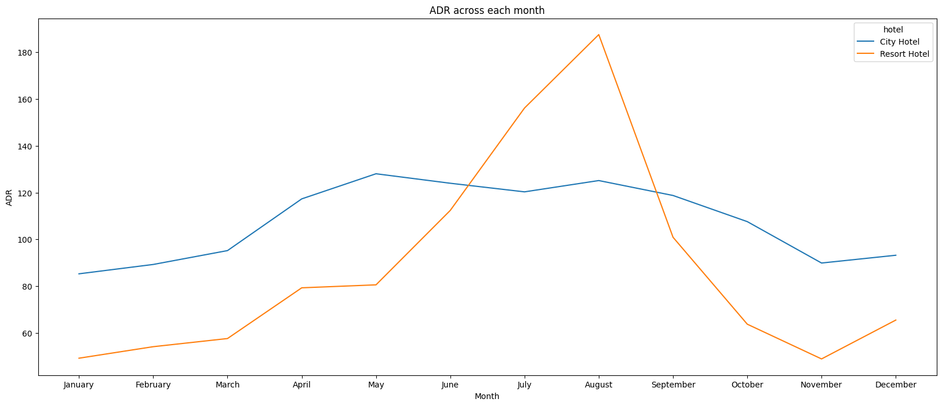
EDA: BIVARIATE AND MULTIVARIATE ANALYSIS
CONCLUSION:
1. ADR for the month of June, July and august increases in case of resort hotel and then plunges significantly.

Slide 14
BUSINESS OBJECTIVE:
To increase hotel business some factors are important like increasing the revenue, customer satisfaction , facilities provided by the hotel , better pricing strategy etc
To achieve the above mentioned objective we were able to figure out which hotel type was the most preferred type, the percentage of repeated guest , most preferred food type and the hotel type with the highest ADR.3
With the most preferred room type figured out in advance we could suggest the hotel to be prepared in advance with all services in the room to enhance customer satisfaction.
With the identification of most preferred food type we can aware the hotel to available with the requisite food type.
Most preferred months can help the hotel to identify the requirement of the hotels in advance so that minimum grievances are faced by the customer.
We were also able to analyse which hotel had the highest ADR.
We were also able to analyse which hotel type was the most busiest so that client can make changes to the less busy hotel’s facility.
Also there was a relationship between the repeated guest and the previous bookings not cancelled so that the client can take necessary action to increase the proportion of repeated guest.

Slide 15
CONCLUSION:
City hotel is most preferred hotel by the guest.
Agent no. 9 made the most bookings.
Percentage of repeated guest is very less which is 3.86%.
Room type A is the most preferred room type.
August month was the most profitable month.
Most preferred food type is the BB food type.
City hotel has the highest ADR which means high revenue.
TA/TO most often used channel for booking and the percentage is 79.13%.
Year 2016 had the most number of and the bookings were 42313.
City hotel has the highest waiting time which shows its business.
Optimal stay length in both the hotels type is less than a week.
Repeated guests do not cancels their bookings while their counter part cancels.
If the number of the people are more then the ADR increases which significantly increases the revenue.

